Slide 1
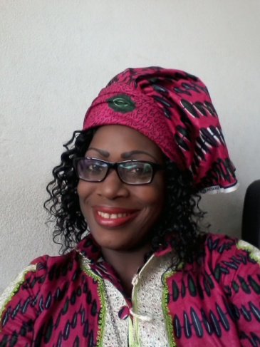
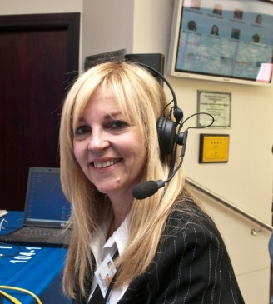
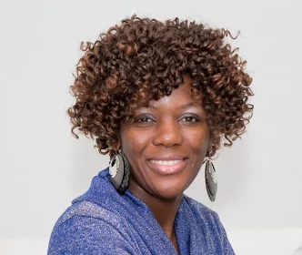
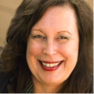
B-r-e-a-k-t-h-r-o-u-g-h-s: Conversations with Leaders From Sub-Saharan Africa: Cameroon and South Africa
VOICES 2016
Sophie Debby Janet Nomso Lucie

Slide 2
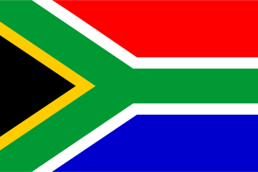
South Africa: Overview
PRESIDENT: Jacob G. Zuma (SECOND TERM)
POPULATION: 51 million
CAPITAL CITIES: Pretoria (Administrative), Bloemfontein (Judicial) and Cape Town (National Assembly)
NUMBER OF PROVINCES: 9
OFFICIAL LANGUAGES: 11
KEY GDP SECTORS: Manufacturing, Business Services, Retail

Slide 3
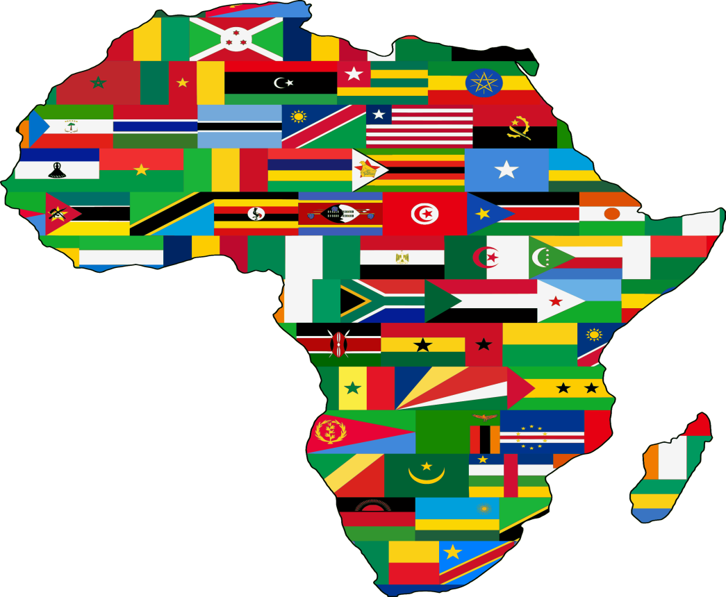
Breakthroughs: Women in STEM in Sub-Saharan Africa
Science and Tech Protocol 30% increase in Female Founders of Tech Startups (1)
• Creating an Enabling Policy Framework
Developing Youth into Science Strategies
Increasing GDP expenditure for R&D
41% Women Political Leaders(3) 47% of STEM are Female PhDs (2) in Sub-Saharan
1) DTI 2014 Report
2) SA Assn.of Women Graduates
3) Women in National Parliaments
1
Average 26% Women in Economic Decision-mak

Slide 4
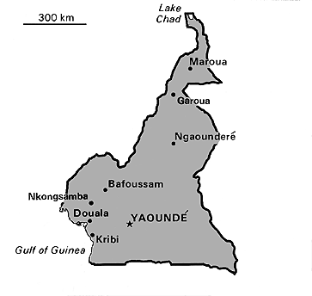
CAMEROON: An Overview
• CAPITAL CITY: Yaoundé
POPULATION: 22.25 million (2013) World Bank
GOVERNMENT: Republic
LANGUAGES: French, English, Fulfulde Adamawa
Motto: "Peace – Work – Fatherland"
French "Paix – Travail – Patrie"

Slide 5
WOMEN IN STEM IN CAMEROON
14 of 193 PROFESSORS IN CAMEROON
25% OF WOMEN IN THE WORKFORCE WORK IN STEM-RELATED FIELDS
32% OF FINAL YEAR HIGH SCHOOL GIRLS ARE ATTRACTED TO STEM
37,5% OF GIRLS IN SECONDARY (HIGH) SCHOOL TAKE STEM COURSES.
STATISTIC OBTAINED FROM HIGHER WOMEN’S CONFERENCE 2015

Slide 6
B-R-E-A-K-T-H-R-O-U-G-H-S: Anatomy of Transformation
As Is
Leverage Points
Breakthrough
Future State

Slide 7
What Does Intentional Change Look Like?

Slide 8
B-r-e-a-k-t-h-r-o-u-g-h-s: Conversations with Leaders From Sub-Saharan Africa: Cameroon and South Africa
VOICES 2016
Sophie Debby Janet Nomso Lucie
ngassas@yahoo.com debby@qualitylife.co.za bihjane@yahoo.com ikhwezilomso@gmail.com hello@newcommglobal.com

